Slide 1
Hackathon Instructions

Slide 2

Hackathon Workflow Implementation – General Instructions
For the given Hackathon Case Study, you are expected to follow all the instructions & implementation given in this document
Batch to be divided into teams, Select a Lead and Name for your team
Identify the responsibilities for each members in teams
Every individual is expected to participate in all the deliverables
Every member of team should be aware of other members' work & their deliverables
Each deliverable & the entire script should be available with each member of a team.
3rd week
Deliverables
4th week
Deliverables

Slide 3

Hackathon Workflow Implementation – Phase 1
Identify functional, UI & End2End flows in the given FRD to decide the functional scope of work
Prepare a Test Plan that includes the Testing process, templates to be used, standards to be followed, Test design process, Test exécution process, Testing Techniques & approach, etc to be followed.
Prepare Test scenarios for the requirements
Derive Test cases for regular System / Functional Testing from the test scenarios. Should cover both the positive and negative scenarios, UI & Functional validations.
Identify Test Cases for Sanity and Regression suite from the System / Functional Test Cases prepared. Prepare RTM as well.
Execute all the Functional, Smoke and Regression suite manually and update the status in Test Case document.
Prepare a Test Summary report, detailing on the execution status & observations
1st Phase
Activities
3rd week
Deliverables
4th week
Deliverables

Slide 4
Hackathon Workflow Implementation – Phase 1
Test Plan Document
Test Scenarios
Test Cases
RTM
Test Summary Report
1st Phase
Deliverables
3rd week
Deliverables
4th week
Deliverables

Slide 5

Hackathon Workflow Implementation – Phase 2
Perform Automation Feasibility Study on the application & prepare a Feasibility Report (Can Selenium identify / locate the fields in the application?)
Build the Hybrid Automation Framework that includes Page Object Model, Data driven library using Apache POI, TestNG, Utilities files, coding standards, naming conventions, code comment standards, indentation guidelines etc. and capture them in the Framework document.
Create Maven project that includes referenced libraries, dependencies & folder structures, etc. Ensure to have structure to integrate the modules & test scripts.
Create Module(Functionality)-wise specific reusable functions
Create Config property file to keep URL, Browser, UserName and password, Keywords, etc.
Create Test Scripts for Test Cases prepared
Implement required TestNG annotations for the tests & suites.
Enable group based execution based on the sanity and regression suite (by leveraging testng.xml)
Implement Automatic rerun utility for failed Test Scripts
1st week
Deliverables
1st week
Deliverables
2nd Phase
Activities
3rd week
Deliverables
4th week
Deliverables

Slide 6
Hackathon Workflow Implementation – Phase 2
1st week
Deliverables
Feasibility Study Report
Framework Document
Maven Structure & Utilities files
Data Library & Classes
Test Scripts
1st week
Deliverables
2nd Phase
Deliverables
3rd week
Deliverables
4th week
Deliverables

Slide 7

Hackathon Workflow Implementation – Phase 3
1st week
Deliverables
Group the identified Sanity and regression suite.
Dry Run and Results consolidation
Categorize the failures; Fix the failures and set it for re-execution.
Prepare the Automation Report to Coaches, Trainers and BU Mentors
Learn Jenkins and see how you can execute your automation suite
Prepare a Retro document on what you have learnt from this exercise, what could’ve been done better & overall experience
Each team member should be able to explain on all the deliverables / activities of the entire hackathon
Individuals will be evaluated by the Mentors on their knowledge & presentation skills
1st week
Deliverables
3rd week
Deliverables
3rd Phase
Activities
2nd week
Deliverables
Demo
With BU
1st week
Deliverables

Slide 8
Hackathon Workflow Implementation – Phase 3
1st week
Deliverables
1st week
Deliverables
Dry Run Report
Final Test Scripts
HTML Reports, Screenshots & Log files
Retro Document
Demonstration
3rd week
Deliverables
3rd Phase
Deliverables
2nd week
Deliverables
Demo
With BU

Slide 9
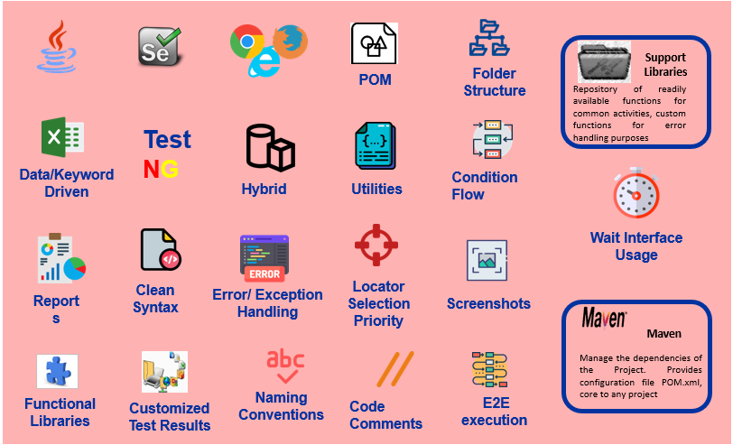

Automation Framework should have below components
Good to have Components

Slide 10
Thank you

